Slide 1


Slide 2



“The thief comes only to steal and kill and destroy; I came that they may have life, and have it abundantly.”
John 10:10 (RSV-2CE)

Slide 3
“Lord, we have left everything and followed you. What then shall we have?”
Matthew 19:27–29 (RSV-2CE)

Slide 4
“All Christians in any state or walk of life are called to the fullness of Christian life and to the perfection of charity”.
Catechism No. 2013

Slide 5
“You, therefore, must be perfect, as your heavenly Father is perfect.”
Matthew 5:48 (RSV-2CE)

Slide 6
“For which of you, desiring to build a tower, does not first sit down and count the cost, whether he has enough to complete it? Otherwise, when he has laid a foundation, and is not able to finish, all who see it begin to mock him,saying, ‘This man began to build, and was not able to finish.”
Luke 14:28–30 (RSV-2CE)

Slide 7

Into the Breach: An Apostolic Exhortation to Catholic Men
Author: Bishop Olmsted
Amazon URL for the book

Slide 8

The Soul of The Apostolate
Author: Jean-Baptiste Chautard
Amazon URL for the book

Slide 9
The Map
Stage 1: Purgative Stage
1st Degree
2nd Degree
3rd Degree
4th Degree
Hardened in Sin:
Surface Christianity:
Mediocre Piety:
Intermittent Piety:
Separated from God by mortal sin; no desire for amendment.
Avoids scandalous sin but remains lukewarm; faith is mostly external.
Avoids mortal sin, some effort at virtue, but shallow roots.
Periods of fervor followed by lapses; easily distracted from spiritual duties.

Slide 10
The Map
Stage 2: Illuminative Stage
Degree 1
Degree 2
Degree 3
Degree 4
Hardened in Sin:
Surface Christianity:
Mediocre Piety:
Intermittent Piety:
5th Degree
6th Degree
Separated from God by mortal sin; no desire for amendment.
Avoids scandalous sin but remains lukewarm; faith is mostly external.
Avoids mortal sin, some effort at virtue, but shallow roots.
Periods of fervor followed by lapses; easily distracted from spiritual duties.
Sustained Piety:
Fervor:
Faithful in prayer and virtue even in dryness or difficulty.
Zeal for God’s glory; embraces sacrifice for souls.

Slide 11
The Map
Stage 3: Unitive Stage
Degree 1
Degree 2
Degree 3
Degree 4
Degree 5
Degree 6
Hardened in Sin:
Surface Christianity:
Mediocre Piety:
Intermittent Piety:
7th Degree
8th Degree
9th Degree
Sustained Piety:
Fervor:
Avoids scandalous sin but remains lukewarm; faith is mostly external.
Periods of fervor followed by lapses; easily distracted from spiritual duties.
Relative Perfection:
Heroic Perfection:
Avoids mortal sin, some effort at virtue, but shallow roots.
Complete Sanctity:
Faithful in prayer and virtue even in dryness or difficulty.
Zeal for God’s glory; embraces sacrifice for souls.
Will is habitually aligned with God; charity saturates my life.
Heroic virtue in daily life; grace flows through every action.
Transforming union; God possesses the soul entirely, summit of the spiritual life.

Slide 12
Tac-Ops
Degree 1
Degree 4
1
Secure the Supply Lines
Live the Sacramental Life
2
Keep COMS Up
Maintain a Consistent Prayer Life
3
Train for the Battle
Be Intentional about Spiritual Formation
4
Live Under Orders
Uniformity to God’s Will
5
Strengthen the Base
Serve My Home First, Everything Else Second
6
Advance with Courage
Conquering Action

Slide 13
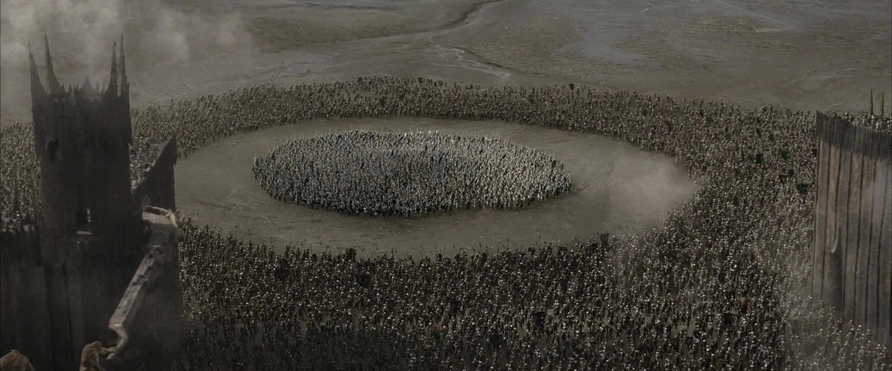

Slide 14
